Slide 1
Estimating Interaction Strengths in Ecological Communities Intro to MAR modeling
Eli Holmes
FISH 507 – Applied Time Series Analysis
5 March 2019

Slide 2
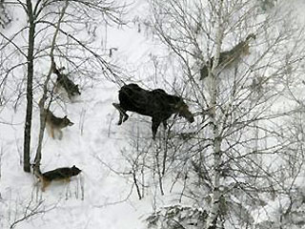
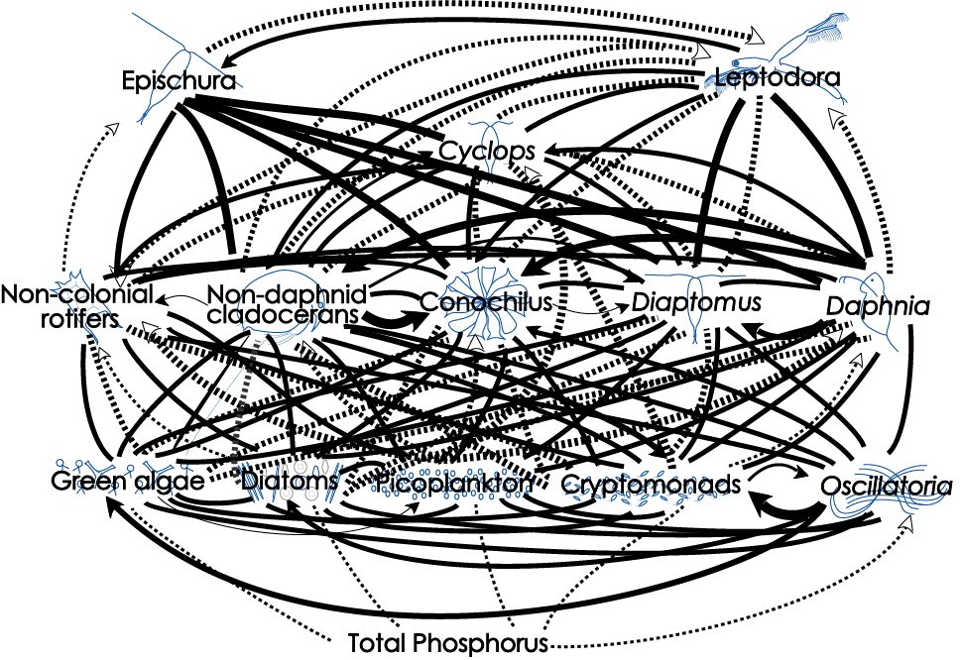
Topics
Univariate and multivariate Gompertz models
Example study: CA kelp forest ecosystem
Simple 2-spp model
2x2 B matrix
Large multivariate models
Big B matrices

Slide 3
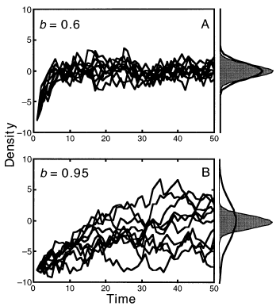
Mean-reverting processes
In lecture, I will talk about estimating mean-reversion in the context of density-dependence and species interactions, but mean-reverting stochastic processes are ubiquitous.
The Ornstein-Uhlenbeck process is the classic continuous time mean-reverting stochastic process. In the population dynamics literature, the Gompertz model is the classic discrete time mean-reverting process (although the Gompertz model also refers to a continuous time version).

Slide 4
Univariate Gompertz models

Slide 5
Density dependence
univariate discrete exponential growth not in log-space
univariate discrete density-dependent growth not in log-space
general
Specific type
The shape of f(n_t-1) determines the dynamics of the system:
stable or unstable equilibrium
Speed at which equilibrium is approached
Equilibrium level
Sensitivity to perturbations

Slide 7
Gompertz model written in log space is AR(1)
Taking the natural log of both sides
Substituting x_{t} for ln n_{t}
AR(1) minus the noise term

Slide 8
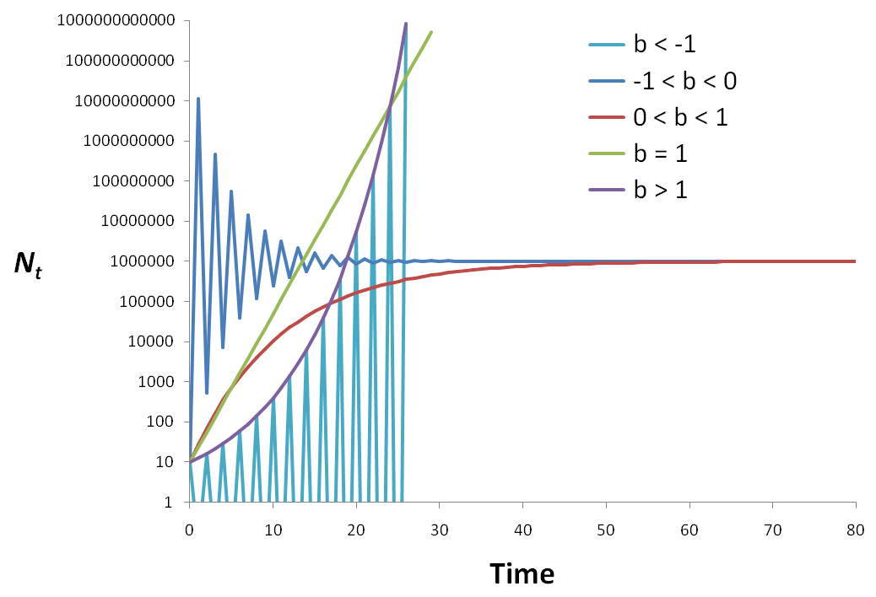
Properties of this model
Our interest
u/(1-b)

Slide 9
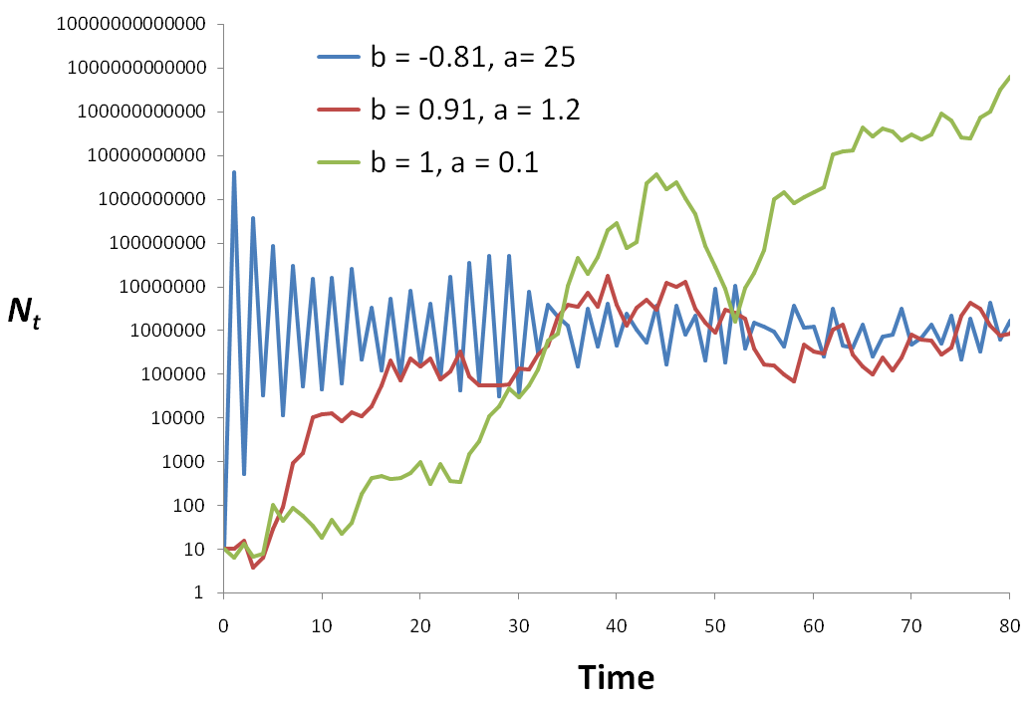
Add stochasticity (process error)
random walk
b=1
2-pt oscillation
u/(1-b)

Slide 10
Equilibrium for the stochastic Gompertz process
It has a stationary distribution
probability distribution of X_{t} as t → ∞
given |b| < 1
Normally distributed with
mean μ∞ and variance υ∞
Fig. 1 - Ives et al. (2003)

Slide 11
Main properties
Basic features of the Gompertz process
Mean reverting, aka density-dependent
Stationary, so it fluctuates around a mean
Point equilibrium as opposed to a cycle equilibrium like Lotka-Volterra (Lynx & hare) models you studied in Ecology 101
Can be seen as a locally linear approximation of other types of density-dependent interaction models
“locally linear” is jargon for “only holds for sure if x doesn’t change too much”. In our case, x = log(n) = log abundance.
S. E. Hampton, NCEAS, UCSB, hampton@nceas.ucsb.edu, 7 July 2007

Slide 12
Real systems do not necessarily have log-linear density-dependence
Note: If N is not spanning very large values a linear model may suffice
Nonlinear
Linear approx.
log N_{t+1}
log N_{t+1}
log N_{t}
log N_{t}
Modern literature on MAR(1) models allow B to be time-varying which allows that linear approximation to vary in time.

Slide 13
observation error is known a problem obs error = spurious density-dependence
2010
2008

Slide 14
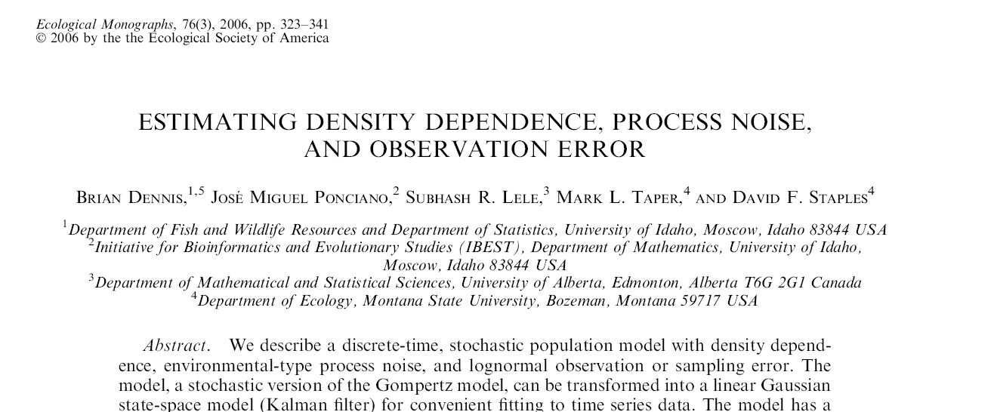
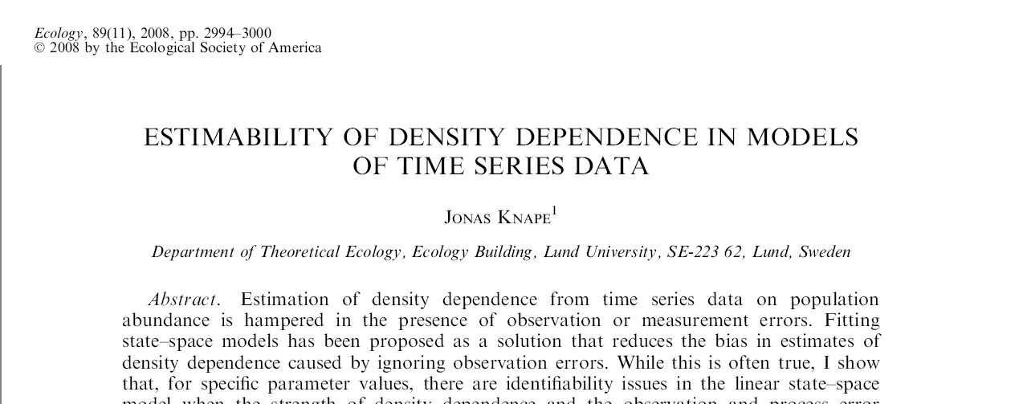
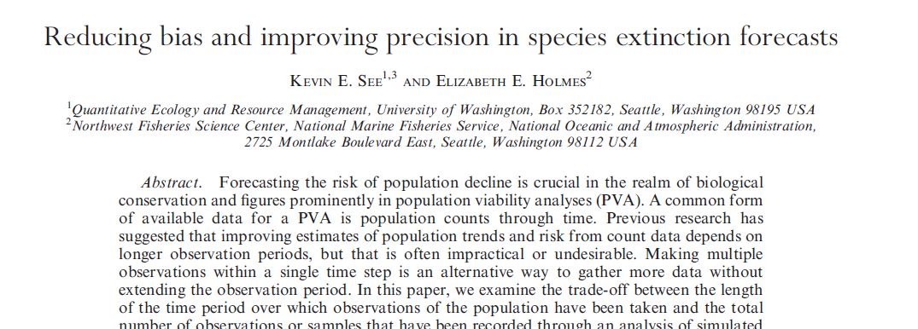
Estimating R matrix is not so easy, but replication helps A LOT
MARSS models (however you fit them) allow you to easily incorporate replication.

Slide 15
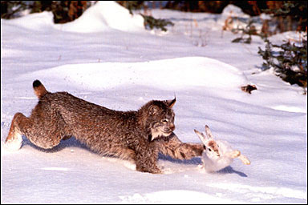
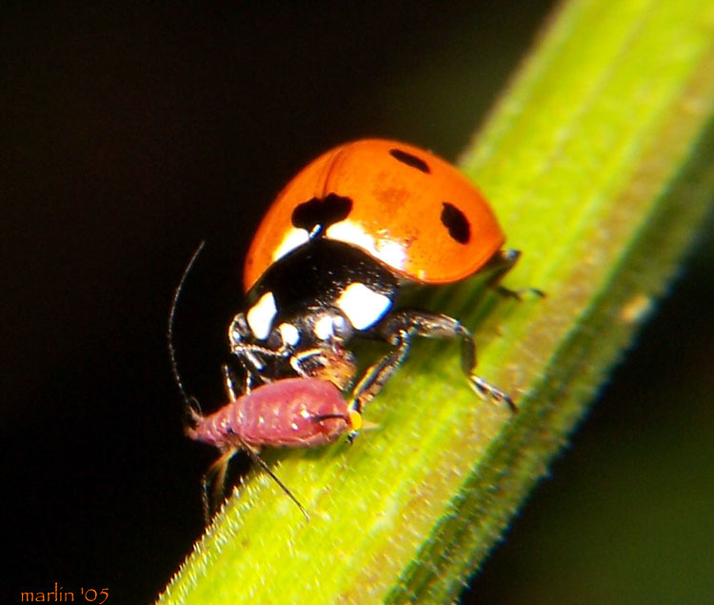
Predator-prey interactions
S. E. Hampton, NCEAS, UCSB, hampton@nceas.ucsb.edu, 7 July 2007

Slide 16
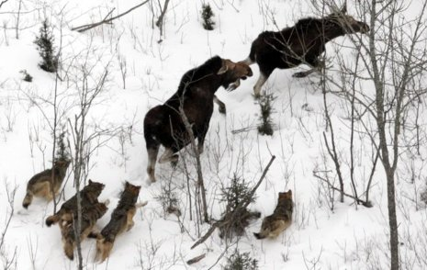
2-species: Predator-Prey
Moose
Wolf

Slide 17
MAR(1): x_{t}=Bx_{t-1} + u + w_{t}
“spp” abundance
B = interaction matrix
Process variation
MVN(0,Q)
Notes:
17
Notice diagonal is different. If diagonal is <1 then b(i,i) is negative and spp i has a negative effect on itself. NOW the variation is added

Slide 18
Adding covariates
covariates
B = interaction matrix
covariate effect
Process variation not from covariates (“unexplained”)
Notes:
18
Notice diagonal is different. If diagonal is <1 then b(i,i) is negative and spp i has a negative effect on itself. NOW the variation is added

Slide 19
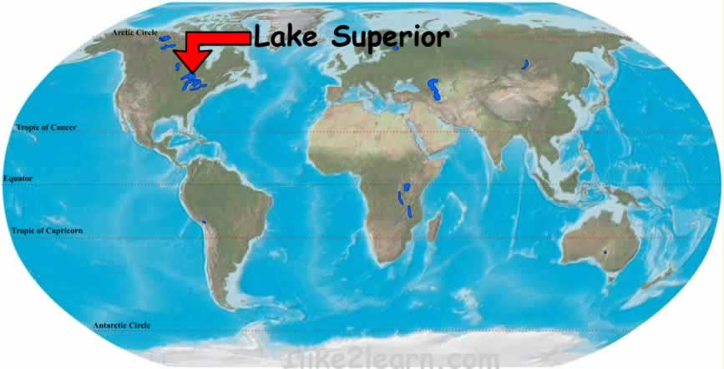
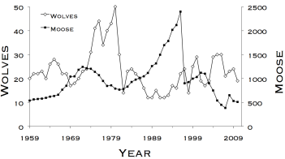
Chapter 14: HWS18a Moose and Wolf example analysis
Effect of winter snow and summer heat on moose and wolves.
data and images from www.isleroyalewolf.org

Slide 20
Using MAR models to understand dynamics in larger communities
Dashed lines are (+) interactions; solid lines are (-)
Hampton et al. (2006)
Notes:
MAR(1) Workshop - ESA 2007, San Jose, CA
5 Aug 2007

Slide 21
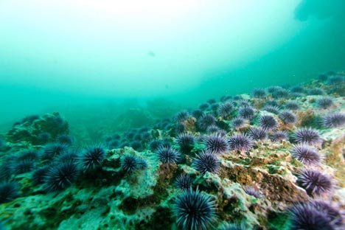
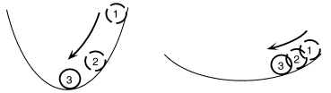
Using MAR models to quantify stability
Notes:
MAR(1) Workshop - ESA 2007, San Jose, CA
5 Aug 2007

Slide 22
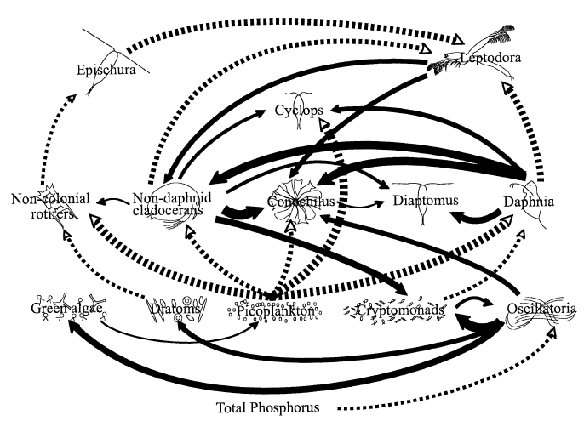
Using MAR models to identify the ‘important’ links
Dashed lines are (+) interactions; solid lines are (-)
Hampton et al. (2006)
Notes:
MAR(1) Workshop - ESA 2007, San Jose, CA
5 Aug 2007

Slide 23
MAR(1) Models
State equation
Observation equation

Slide 24
MAR(1) Models
State equation
Observation equation
f(…)
Another observation error model

Slide 25
Multivariate AR(1) process
B matrix structure:
Inter-specific effects
(can be set to zero)
Inter-specific effects
(can be set to zero)
Intra-specific effects

Slide 26
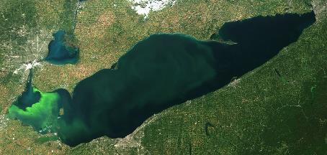
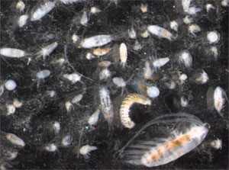
MAR(1) models have been widely used to study dynamics of plankton communities
Many ecological applications are reviewed in
Hampton, S.E., E.E. Holmes, D.E. Pendleton, L.P. Scheef, M.D. Scheuerell, and E.J. Ward. 2013. Quantifying effects of abiotic and biotic drivers on community dynamics with multivariate autoregressive (MAR) models. Ecology 94:2663-2669

Slide 27
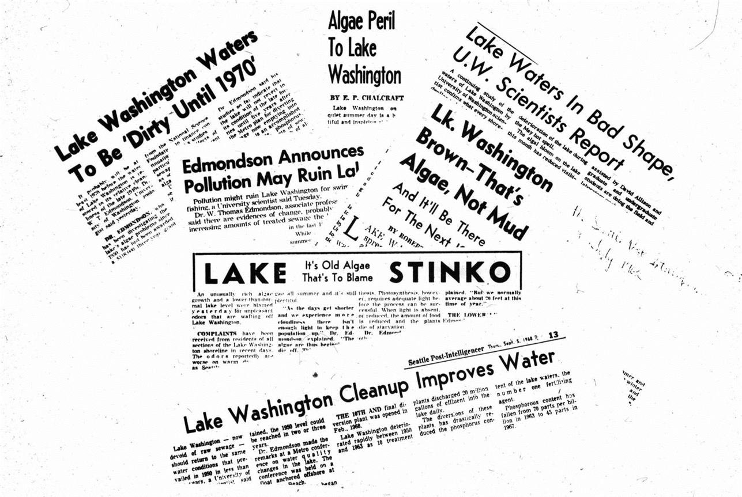
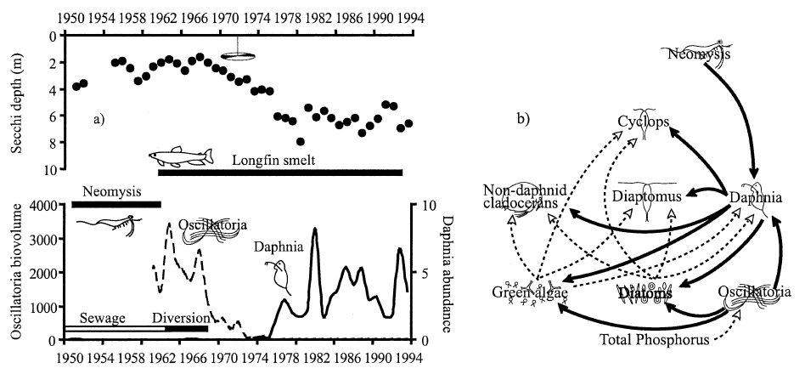
Lake Washington: a large change in sewage inputs in the late 1960s led to a dramatic change in the plankton community
Hampton et al. (2006)
Notes:
MAR(1) Workshop - ESA 2007, San Jose, CA
5 Aug 2007

Slide 28
Multivariate AR(1) process, “MAR1”
Note no SS part
Assume p different interacting species, then for each sp. i:
B
X_{j,t-1} is abundance index of species j at time t-1
b_{ij} is effect of species j on species i
Note: when i = j, b_{ij} is effect of species i on itself

Slide 29
Multivariate AR(1) process
Can add effects of q different environmental covariates:
q=2
c_{k,t} is covariate k (e.g., temperature) at time t
C_{ik} is effect of covariate k on species i

Slide 30
Multivariate AR(1) process
Can write all of this as:
x_{t} is p x 1 vector of species abundance at time t
u is p x 1 vector of intrinsic growth rates
B is p x p matrix of density-dependent effects
x_{t-1} is p x 1 vector of species abundance at time t-1
C is p x q matrix of covariate effects
c_{t} is q x 1 vector of covariate values at time t

Slide 31
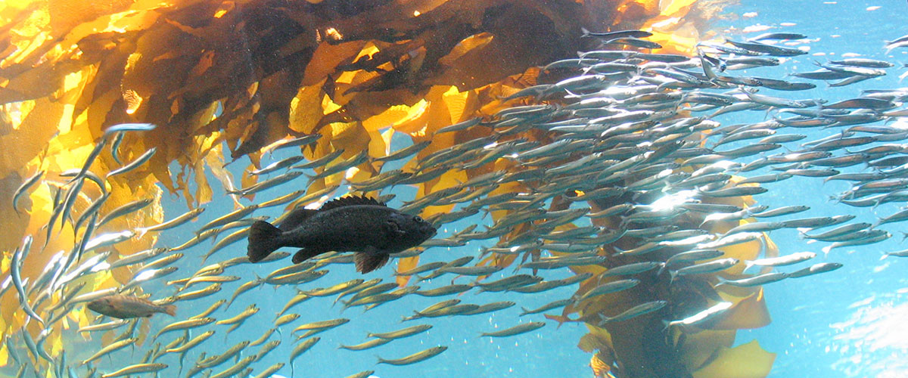
Estimating changes in species interactions & community stability in a kelp forest ecosystem
Mark Scheuerell NOAA Northwest Fisheries Science Center
Eric Ward NOAA Northwest Fisheries Science Center
Steve Katz Washington State University

Slide 32
Acknowledgments
United States taxpayers
Eli Holmes, Jim Thorson, Eric Buhle
Lots of other students, post-docs & unsuspecting colleagues

Slide 33
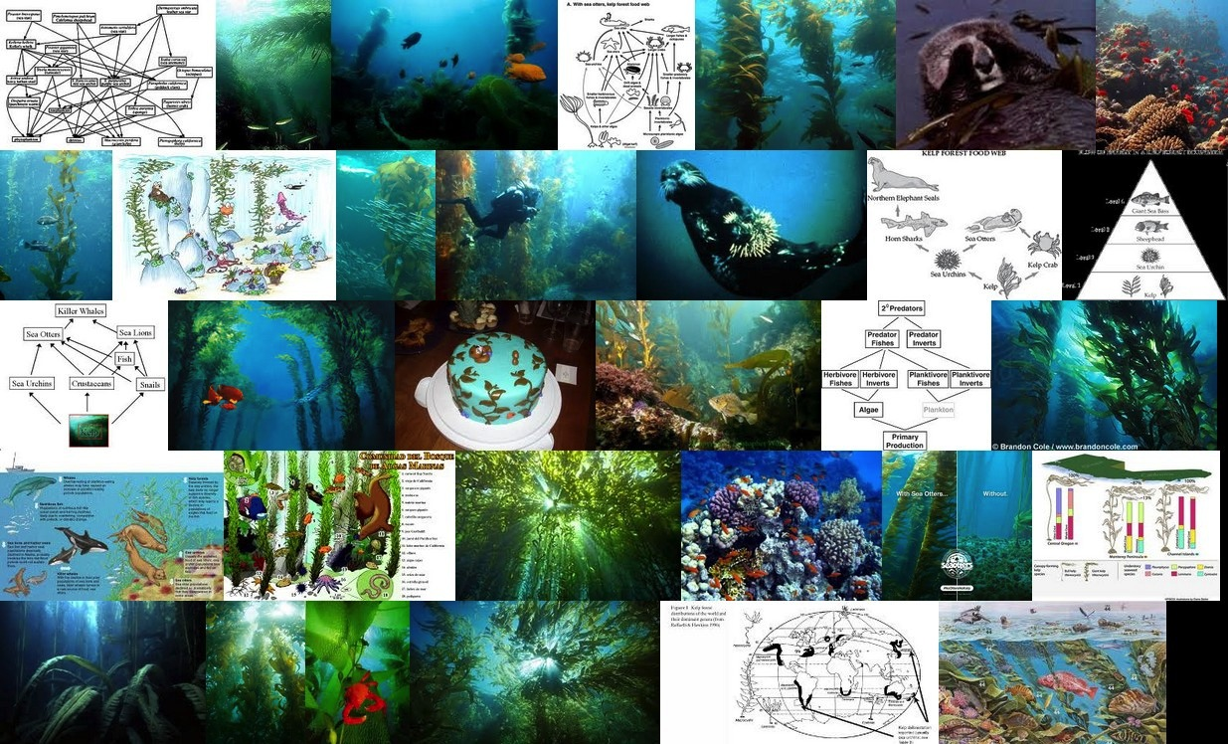
Kelp forest ecosystems
Images courtesy of Google & ImageQuilts
Notes:
Kelp forest ecosystems occur globally along temperate-zone coast lines, and are some of the most diverse and productive ecosystems of the world. They also provide a wide array of ecosystem services that have sustained human communities for millenia. Kelp forest ecosystems have also been the subject of many ecological studies examining the structure and function of food web dynamics.

Slide 34
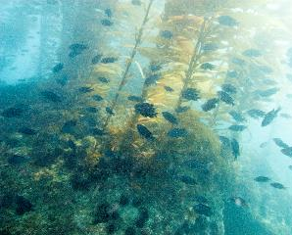
Conventional wisdom
Otters
Urchins
Kelps

Slide 35
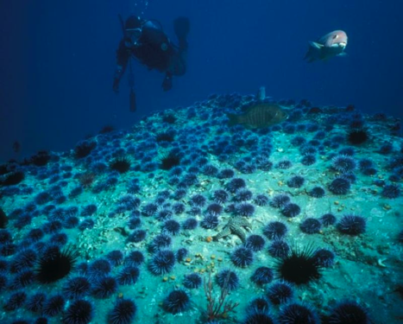
Conventional wisdom
Otters
Urchins
Urchins
Kelps
Kelps
Images courtesy of R Schwemmer & NPS

Slide 36
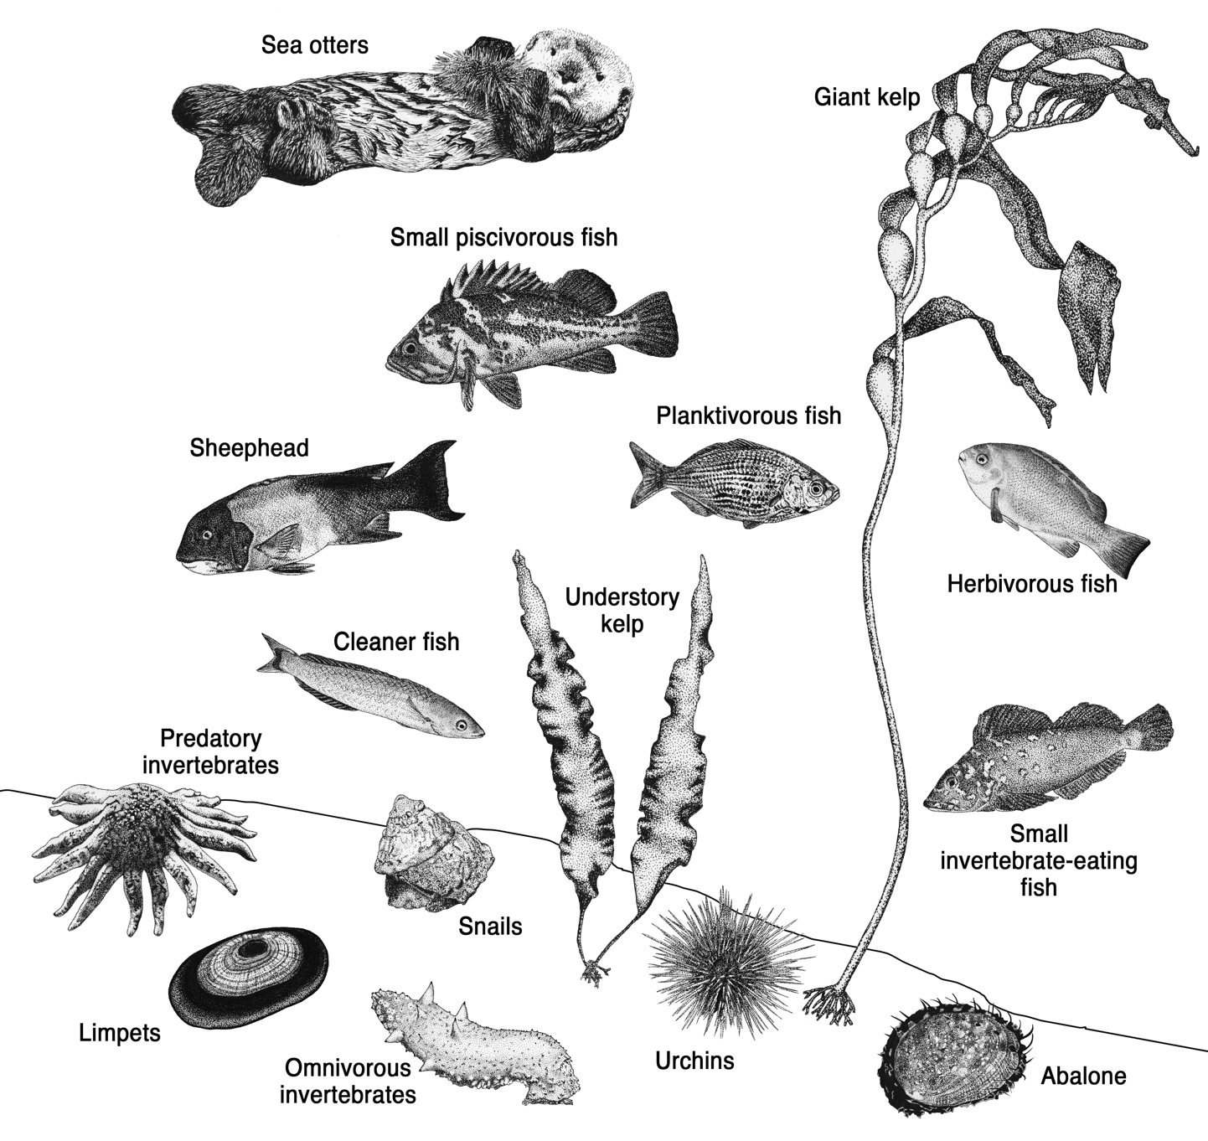
Artwork by Shannon Hennessey

Slide 37
Questions about the larger community
Fish-eaters
1) How do community interactions change over time?
Otters
Invert- eaters
2) How do we tease out interaction changes in the face of environmental changes?
Invert grazers
Herb. fish
Kelps

Slide 38
Community model in matrix form
Intrinsic
growth rates
Covariate
effects
log densities
Environmental
variation
Interactions
strengths
Covariates
Ives et al (2003) Ecology

Slide 39
Two issues with this model
1) This describes a process with no sampling or observation error
2) The community interactions don’t vary with time

Slide 40
State-space model
State equation
Observation equation

Slide 41
State-space model
State equation
Observation equation

Slide 42
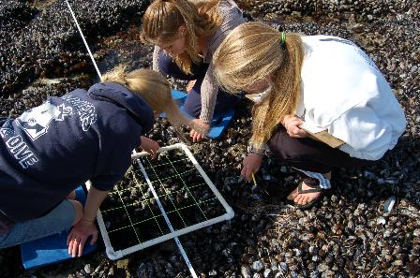
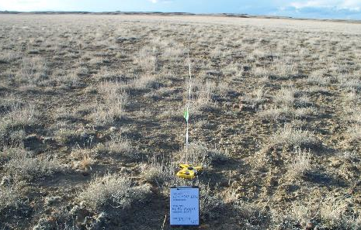
Count data are the basis for many studies
© KQED
log(0) = -Inf (!)
© NW College of Agriculture

Slide 43
Allowing for count data
Observation of guild g at location i at time t
State

Slide 44
Time-varying interactions
State equation

Slide 45
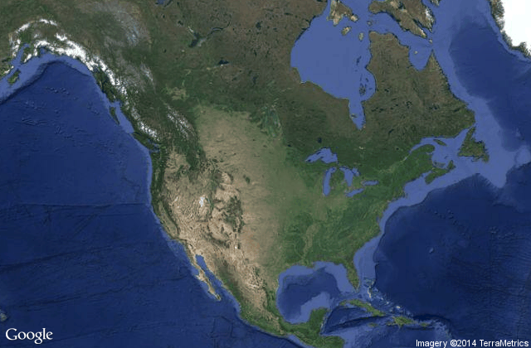
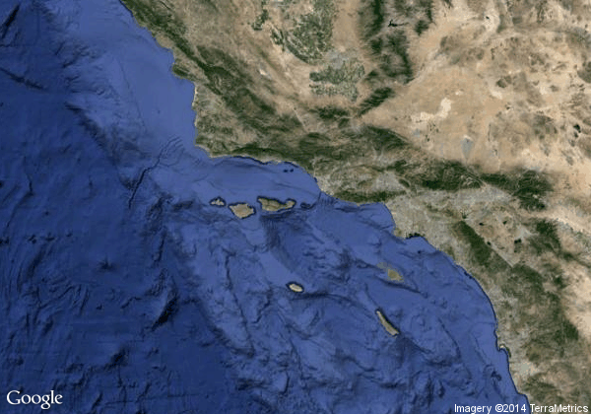
Kelp forests in southern California
Los Angeles
San Nicolas Island
Images courtesy of Google

Slide 46
Data for San Nicolas Island
Kenner et al (2013) A multi-decade time series of kelp forest community structure at San Nicolas Island, California (USA). Ecology 94:2654
7 sites around the island
Biannual surveys from 1980-2011 (n = 63)
Divers collect data on:
Fish (59 spp)
Inverts (14 spp)
Kelps (6 spp)
Image courtesy of Google

Slide 47
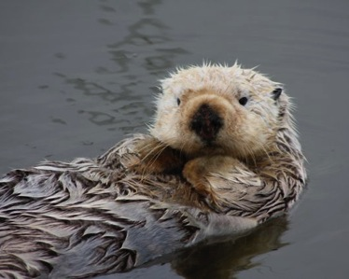
Sea otters at San Nicolas
Otters absent for >100 yr prior to 1987
Image courtesy of Steve Lonhart

Slide 48
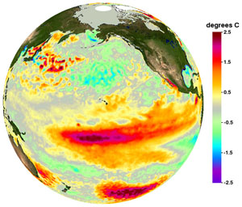
El Niño around San Nicolas
Image courtesy of NOAA

Slide 49
Urchin harvest at San Nicolas
Data from Calif Dept Fish Wildlife

Slide 50
Fitting the model
6 observations of 4 states 1980 to 2011
Each state has same
MCMC via JAGS to allow observation errors with negative binomial error model.

Slide 51
B matrix
Inter-specific effects
Intra-specific effects

Slide 52
Changes in density & density-dependence

Slide 53
Examples of trophic effects
Top-down
Bottom-up

Slide 54
sanctuaries.noaa.gov

Slide 55

Stability

Slide 56
Stationary distribution for MAR(1)
Mean vector:
Covariance matrix:
(analogous to the univariate case)
The theory in this part of the lecture draws from
Ives AR, Dennis B, Cottingham KL, Carpenter SR. 2003. Estimating community stability and ecological interactions from time series data. Ecological Monographs 73: 301-330

Slide 57
Stability properties of MAR(1) models
Our interest is in stable systems
(i.e. all eigenvalues of B lie within unit circle)
Stability can be measured in several ways, but here are three that we will use:
Stability measure | More stable when…
Variance | variance of the stationary distribution is low relative to that for the process error
Return rate | rapid approach to the stationary distribution (i.e. high return rate)
Reactivity | fewer departures from the mean of the stationary distribution (i.e. low reactivity)

Slide 58
Stability properties of MAR(1) models
Return rates (ie, resilience)
In stochastic models, equilibrium is the stationary distribution
Rate of return to the stochastic equilibrium is the rate at which the transition distribution converges to the stationary distribution from an initial, known value
The more rapid the convergence, the more stable the system
More stable
Less stable
Fig. 2B - Ives et al. (2003)

Slide 59
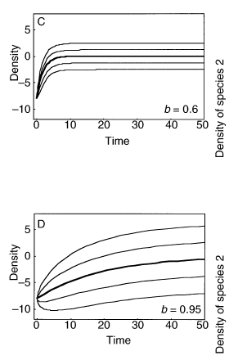
Stability properties of MAR(1) models
Return rates
Rate of return increases as |b| gets smaller
Rate of return to mean governed by dominant eigenvalue of B ≡ max(λ_{B})
Rate of return of covariance defined by dominant eigenvalue of B⊗B ≡ max(λ_{B⊗B})
Take home msg: you can write the return rate as a function of B. So if we can estimate B, we can say something about the stability of the system as measure by return rate.
Fig. 3 - Ives et al. (2003)

Slide 60
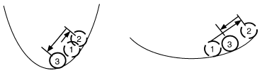
Stability properties of MAR(1) models
Reactivity
A “reactive” system moves away from a stable equilibrium following a perturbation, even though the system will eventually return to equilibrium.
Low reactivity
High reactivity
Fig. 2C - Ives et al. (2003)
High reactivity occurs when species interactions greatly amplify the environmental forcing
Not how fast does it return but how far does it go?

Slide 61
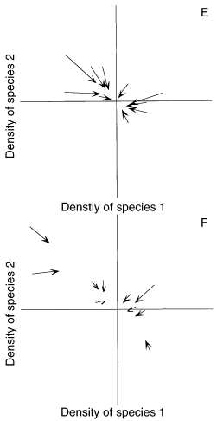
Stability properties of MAR(1) models
Reactivity
Squared Euclidian distance for X_{t-1} from μ∞
Squared Euclidian distance for X_{t} from μ∞
Change in squared Euclidian distance
Expectation of this difference
Fig. 3 - Ives et al. (2003)
“worst-case” scenario
Another form of reactivity is given in Neubert et al. (2009)

Slide 62
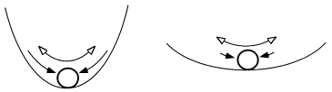
Stability properties of MAR(1) models
Variance comparison
Generally interested in the time spent away from equilibrium
More time → greater variance
More stable
Less stable
Fig. 2A - Ives et al. (2003)
Combines properties of both return rate and reactivity

Slide 63
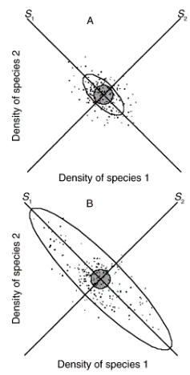
Stability properties of MAR(1) models
Variance comparison
1)
Smaller λ → smaller υ → more stable
2)
To standardize across various systems
Smaller λ → smaller det(B)^{2/p} → more stable
Fig. 3 - Ives et al. (2003)

Slide 64

Estimating changes in stability
Francis TB, Wolkovich EM, Scheuerell MD, Katz SL, Holmes EE, et al. (2014) Shifting Regimes and Changing Interactions in the Lake Washington, U.S.A., Plankton Community from 1962–1994. PLOS ONE 9(10): e110363. https://doi.org/10.1371/journal.pone.0110363
https://journals.plos.org/plosone/article?id=10.1371/journal.pone.0110363

Slide 65
Monthly mean densities of Daphnia, non-Daphnia, Oscillatoria, and diatoms and green algae. Francis et al. 2014.

Slide 66
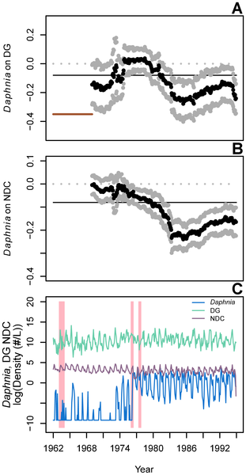
Shifting effects of Daphnia on other species. Francis et al. 2014.

Slide 67
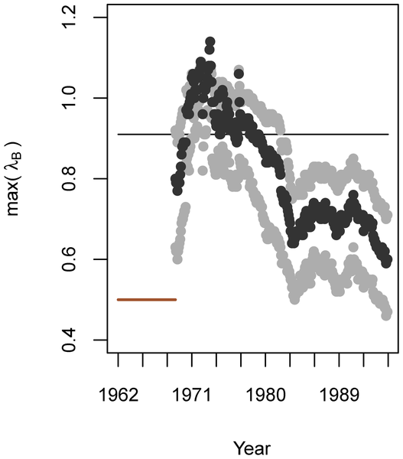
Unstable
More stable
Shifting stability in the community. Francis et al. 2014.

Slide 68

Finding the important structure

Slide 69
Goal is to find a simpler system to explain the observed species changes
13 x 13 B matrix
Compare model support of models with different B’s set to zero
156 non-diagonal B terms. There are approximately 1e+47 (that’s 1 followed by 47 zeros) unique B matrices with different 0s.
We cannot do a brute force fitting of all models.
We should try to set some of those Bs to 0 via prior knowledge about the system
We need a fast estimation algorithm
Notes:
MAR(1) Workshop - ESA 2007, San Jose, CA
5 Aug 2007

Slide 70
Search strategies

Slide 71
Search strategy for large model spaces
Best of 100 random search
100 models are generated by randomly including (50/50) each b element.
Best model (lowest AIC or BIC) is saved
Repeat 100 times to get a set of 100 “best” model.
Remove any variables that appears in less than 15 of the 100 best models.
Repeat the ‘Best of 100’ search (steps 1-3) with the new smaller set of variables.
Repeat steps 1-5 until number of variables in the 100 best is stable and chose best model.

Slide 72
Search strategy for large model spaces
Exhaustive via “leap and bound” algorithm
Algorithms to find best model over all possible variable combinations without actually doing exhaustive search.
Forward step-wise
Start with no off-diagonal b.
Add the b that most improves (reduces) model AIC
Stop at some step-AIC threshold
Backward step-wise
Same as forward but start with full model (all b’s)

Slide 73
Model diagnostics
Once selected, a MAR(1) model should be scrutinized
Useful diagnostics include:
Are residuals temporally autocorrelated (via ACF)?
Are mean or variance of the residuals correlated with any variates or covariates (via X-Y plots)?
Are residuals normally distributed (via normal probability plots)?
What proportion of the variance is explained by the model (via conditional R²)?
Note: conditional R² measures the proportion of change in log density from time t-1 to t

Slide 74
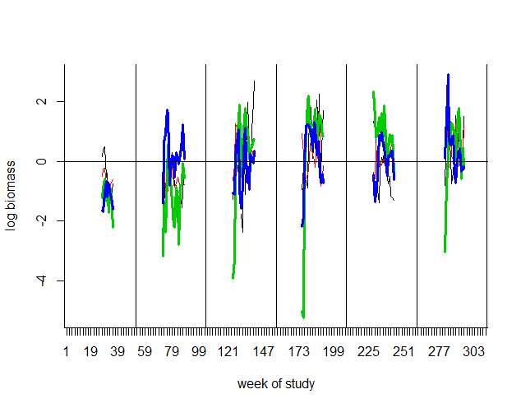
Model diagnostics example
Example of demeaned plankton data, 4 spp (Ives et al 2003)
we are fitting one B matrix (and u)
so level changes need to be explained by the covariates

Slide 75
Chapter 14: HWS18a Ives et al. analysis
Fit a MAR community model to freshwater plankton data from Ives et al. (2003)
Add covariates to the above model
Add an additional covariate (fish) observed with error
Compute stability metrics
See MAR1 package on CRAN to apply the Ives et al. 2003 and other search algorithms to data sets.

